Slide 1


Making Your Business
Run Better
CRM, CCM, QA, eLearning

Slide 2
























is trusted by many blue chip clients in Ireland and internationally.
Financially Regulated
Business Process Outsourcing
Telecommunications
Utility / Government
Significant Others

Slide 3


Making Your Business Run Better
Contact
Management
Customer
Relationship
Management
eLearning
Quality Assurance
Systems Integration

Slide 4
Innovation

Slide 5









From the ground up
PHP
Programming Language
MySQL
Database Engine
Apache
IIS
IIS
Web Server Engine
Linux
Windows
Windows
Operating System
LAMP
WISA
WIMA

Slide 6
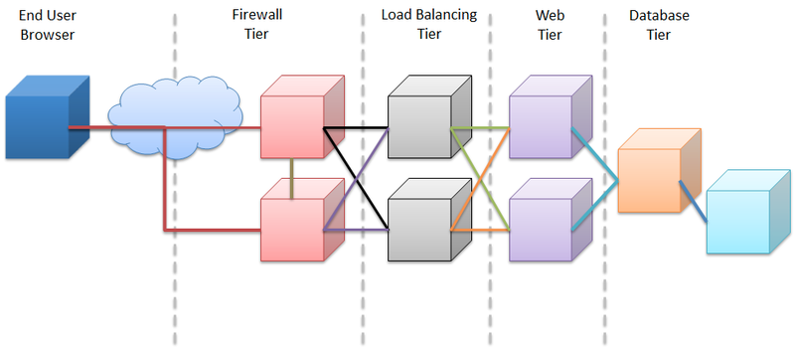
Complete security

Slide 7
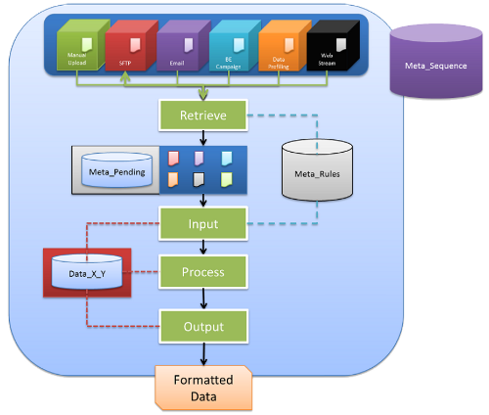
A single version of the truth

Slide 8
Reporting

Slide 9
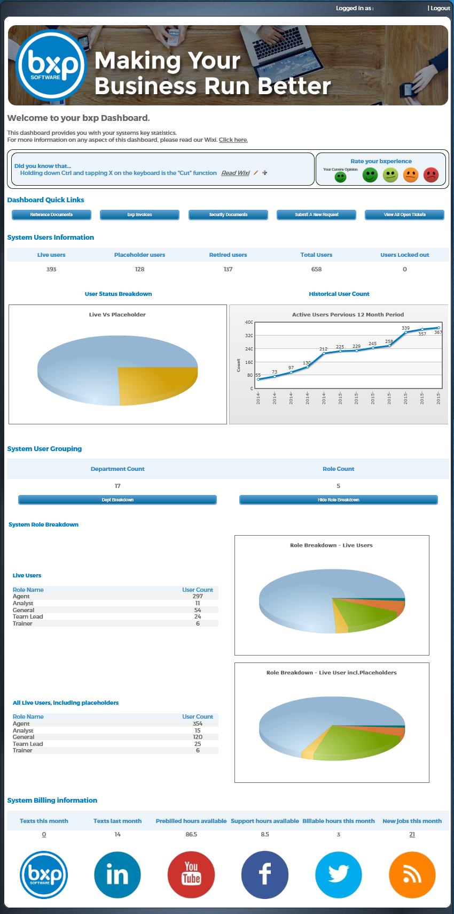
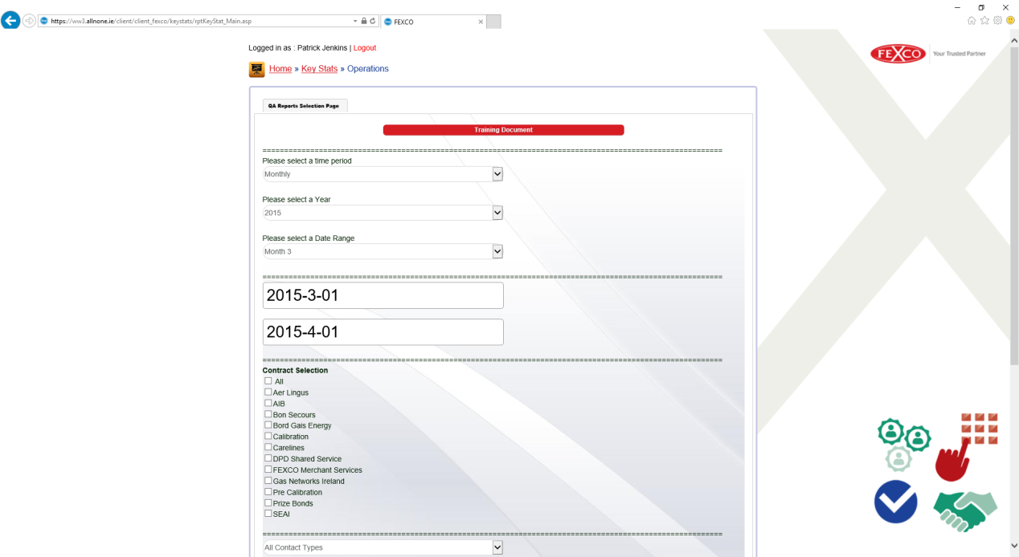
bxp client dashboard report
FEXCO quality management

Slide 10
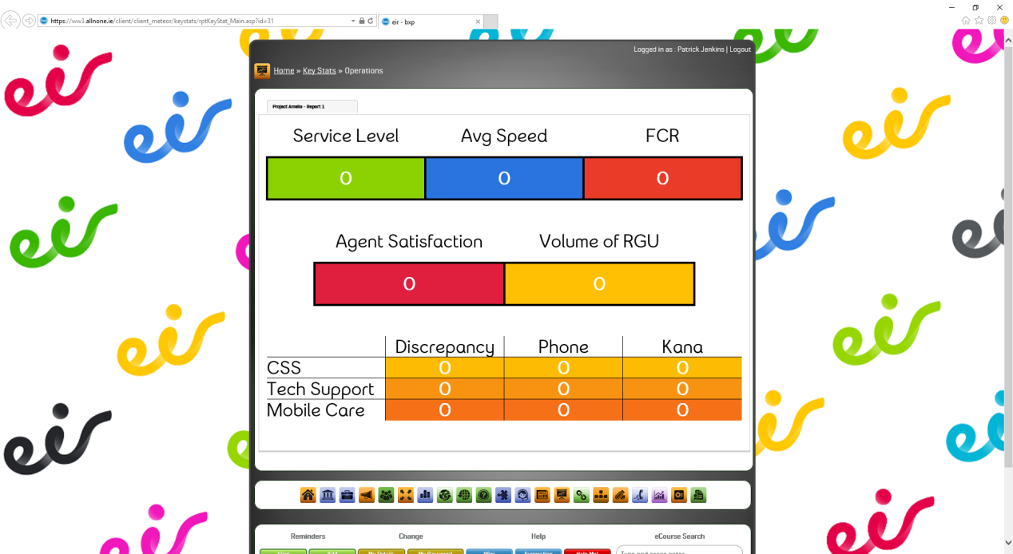
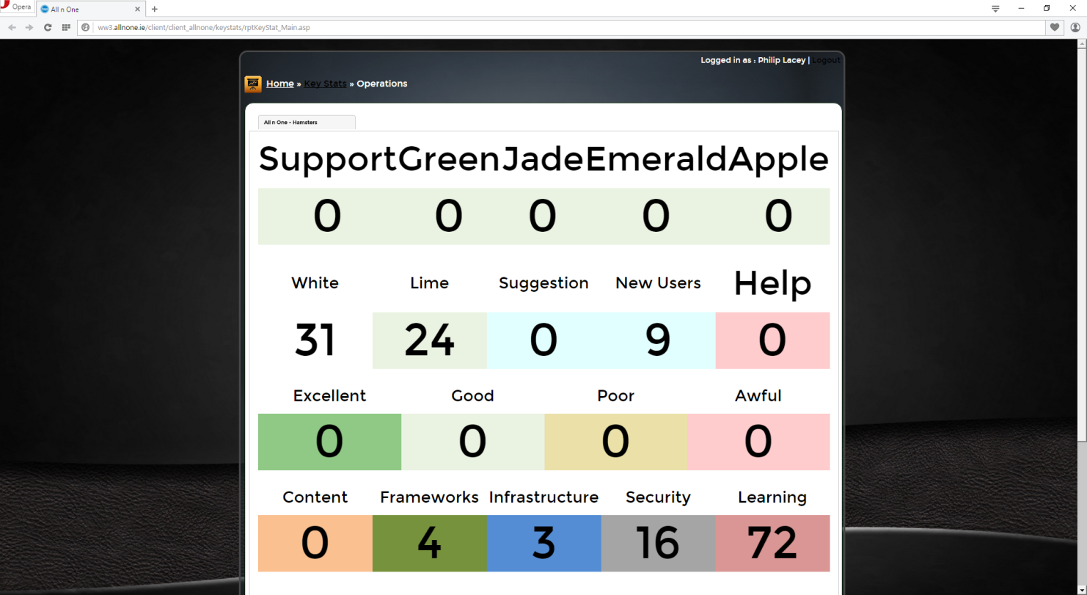
eir supplier management
All n One operations
management

Slide 11
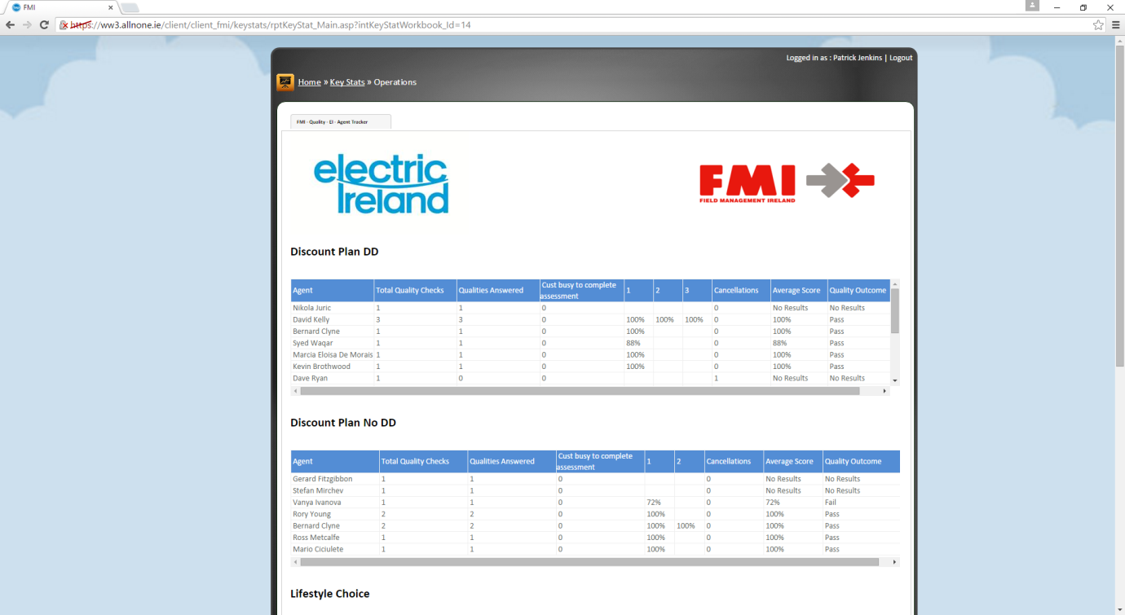
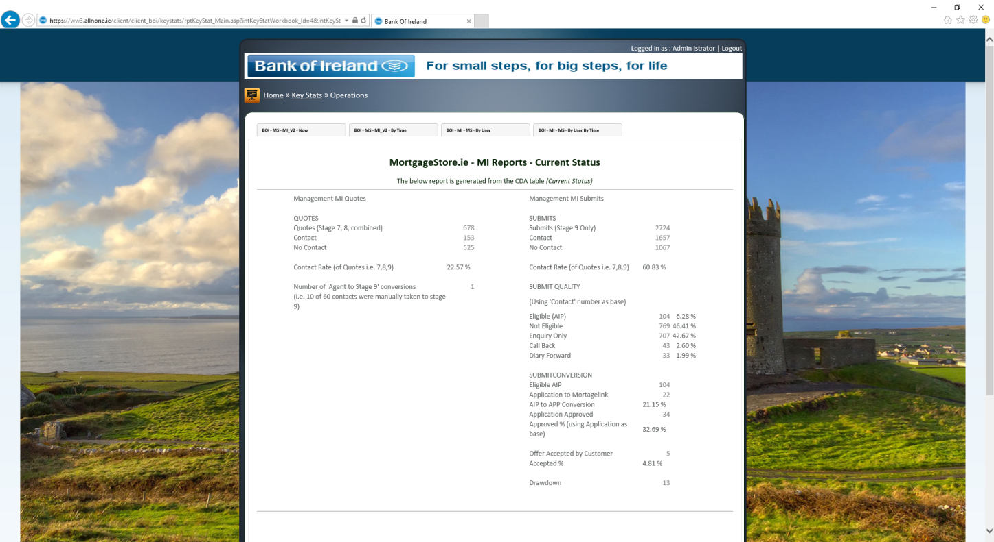
FMI Client Reporting
BOI operations
reporting

Slide 12
Why Us?

Slide 13
Why do business with All n One?
25+ years Business Process Experience
Highly trusted partners
100% secure service provision
Passionate about Innovation
Proactive in thought leadership
Low cost licence model producing high value savings
Strong investment return ratio

Slide 14
Accreditations / Awards
2008 - CCMA Awards - Winner –
  Best New Product or Service
2009 - CCMA Awards - Highly Commended –
  Best Contact Centre Supplier
2010 - CCMA Awards - Winner –
  Best New Product or Service
2010 - CCMA Awards - Winner –
  Contact Centre Supplier of the Year
2011 - CallCentreHelper.com –
  The Top 25 Contact Centre Technology
2012 - Irish Sales Champion Awards - Winner –
  Best Use of Sales Technology 2012

Slide 15
Our Background

Slide 16
History
Established 2005
10 Employees
Offices: Dublin, Belfast, London
Highly Technical Team: BSc+ minimum
Multi-Award Winning

Slide 17
Our Offering
Business Process Modelling and Management Toolkit
SaaS Based Service
Self Service Format - No IT Support Needed
Access on Any Device From Anywhere
Highly Secure
ISO27001 & ENISA Compliant

Slide 18
Our Product

Slide 19
Making Your Business Run Better
Contact
Management
Customer
Relationship
Management
eLearning
Quality Assurance
Systems Integration

Slide 20
Making Your Business Run Better
Contact
Management
Customer
Relationship
Management
eLearning
Quality Assurance
Systems Integration
Contact Centre Management
bxp software turns your customer data into useful information, improving marketing effectiveness, increasing revenue, and preventing customers from defecting.

Slide 21
Making Your Business Run Better
Contact
Management
Customer
Relationship
Management
eLearning
Quality Assurance
Systems Integration
Customer Relationship Management
bxp software turns your customer data into useful information, improving marketing effectiveness, increasing revenue, and preventing customers from defecting.

Slide 22
Making Your Business Run Better
Contact
Management
Customer
Relationship
Management
eLearning
Quality Assurance
Systems Integration
eLearning
Our eLearning tools are highly adaptable which means you can tailor bxp to exactly match your business needs. Loading documents, spreadsheets, audio-visual presentations or films couldn’t be easier so you can be sure your students will enjoy the most efficient training available

Slide 23
Making Your Business Run Better
Contact
Management
Customer
Relationship
Management
eLearning
Quality Assurance
Systems Integration
Quality Assurance
bxp software allows you to assess and measure Quality Assurance against your criteria, your rules and your standards at the times that are best for your business.

Slide 24
Our Clients

Slide 25
Case Study
FEXCO is one of Ireland’s leading Contact Centre Outsource Partners. Their offering includes Multi-channel Capabilities, Customer Satisfaction and Quality Training
FEXCO’s Resource Planning department currently deals with over 100 daily tickets from across a multi-site environment. Incoming
tickets were not efficiently
categorised, and they did not have search or reporting capabilities.
By using a blended form in conjunction with a work list, bxp created a Ticketing Tool that logged all tickets sequentially

Slide 26
Case Study
bxp pre-populates fields using logic management and through the intelligent use of outcomes they are able to communicate instantly with topic specialists or, for example, set automated calendar reminders.
We are still in the pilot phase of this concept and are already seeing great improvements in the quality of the information received which has led to an increase in first call resolutions.
Patrick Falvey,
Solution Developer,
FEXCO

Slide 27

Case Study
On 15 July 2014, 3Mobile and O2 combined to create a truly impressive network. By combining the scale of O2 and Three’s passion for innovation, they provide great value with an even better network performance.
Following this successful acquisition, 3Mobile faced the
challenge of training new staff members to build
their knowledge of internal processes and procedures.
For example, they needed to train retail staff on store systems, including, cash and card transactions.
They also needed to provide information on products, promotions, and special deals.

Slide 28
Case Study
Having previously delivered training through a blend of classroom and desk-side training. 3 wanted to improve their training by making the training more accessible, faster and more varied.
The flexibility of bxp’s eLearning platform means that virtually any media can be loaded in seconds and the relevant personnel can access the material from any location on any device.
bxp has significantly reduced the time taken both to create the material, and to deliver it, taking travel, for example, virtually out of the picture. Taking into account content management combined with trainers and trainee time, the number of man hours saved is already being measured in the hundreds.
Raquel Hanley, Head of L & D

