Slide 1


Making Your Business
Run Better
CRM, CCM, QA, eLearning

Slide 2
The Theory and Delivery of Gamification
http://www.bxpsoftware.com/wixi/index.php?title=Scenario_-_bxp_for_Gamification
Author: Philip Lacey
Date: 2015-07-10

Slide 3
Background

Slide 4

Who motivates staff?
Team Leaders
Managers
Training
Externals
People themselves

Slide 5
Understanding Gamification
What is Gamification?
https://badgeville.com/wiki/Gamification
Gamification is the concept of applying game mechanics and game design techniques to engage and motivate people to achieve their goals. Gamification taps into the basic desires and needs of the users impulses which revolve around the idea of Status and Achievement.

Slide 6
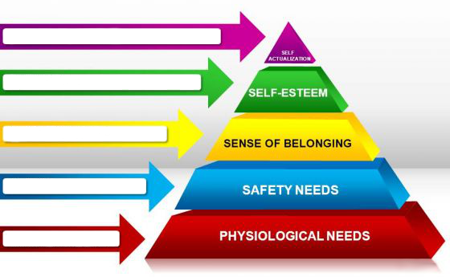
Personal Needs
http://www.slidegeeks.com/pics/dgm/l/g/goal_maslows_hierarchy_of_needs_3d_powerpoint_slides_and_ppt_diagram_templates_1.jpg

Slide 7
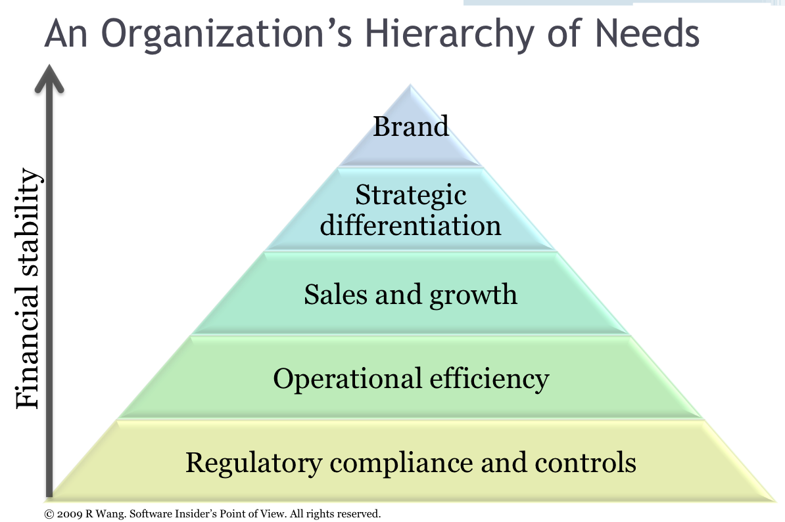
Business Needs
http://blog.softwareinsider.org/wp-content/uploads/2009/09/screen-shot-2009-09-07-at-101728-pm.png

Slide 8
Stimuli
So using the definition of:
Gamification taps into the basic desires and needs of the users impulses which revolve around the idea of Status and Achievement.
Gamification stimulates:
Competition
Achievement
Status
Altruism
Community Collaboration

Slide 9
Challenges

Slide 10
Conflict
The motivations of the person are not necessarily the motivations of the business.
Business rules and regulations can make people nervous of failing and retribution
Personal Safety Needs, are not necessarily the same as Operational Efficiency, hence the poor working conditions in the early 1900s

Slide 11
Not everything is motivational
Career analyst Dan Pink examines the puzzle of motivation, starting with a fact that social scientists know but most managers don't: Traditional rewards aren't always as effective as we think. Listen for illuminating stories — and maybe, a way forward.
https://www.ted.com/talks/dan_pink_on_motivation

Slide 12
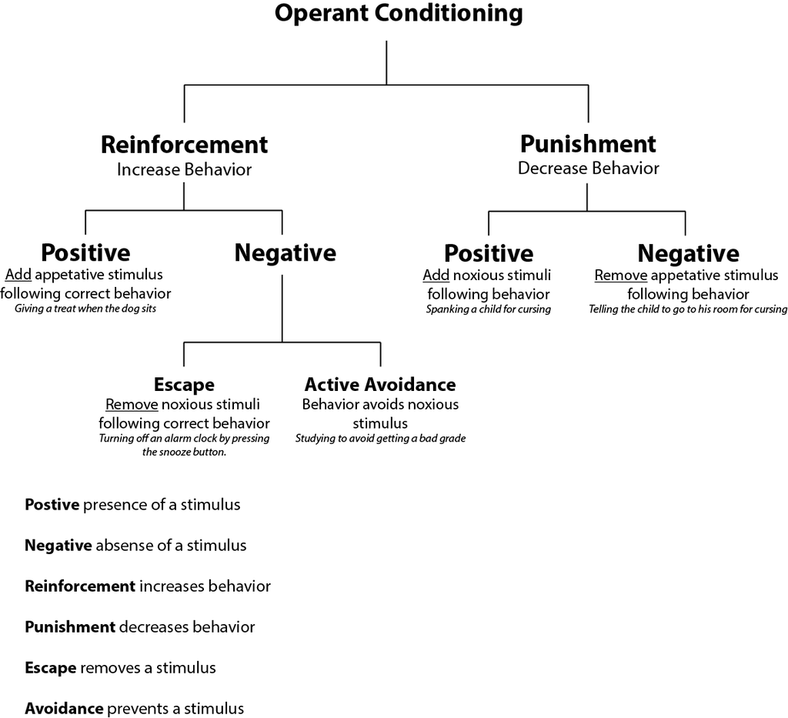
Management of Behaviour
https://en.wikipedia.org/wiki/Reinforcement

Slide 13
Everyone is different
The biggest challenge of all is that every person is completely different with different backgrounds and focii.
The ideal solution is to individually assess every person and set approaches and goals on a person by person basis. This is not generally operationally feasible.

Slide 14
The Setup

Slide 15
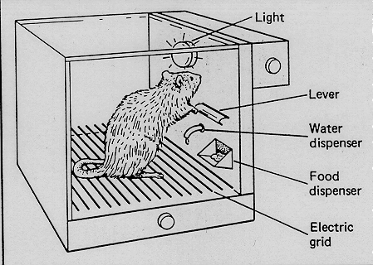
Starting
Classical conditioning became Behaviourism . Rewarding good behaviour and punishing bad behaviour. Gamification uses only half of this, the good behaviour side. For the most part positive reinforcement is used in gamification. i.e. No negative marking.
Essentially gamification is the psychological manipulation of people to achieve the goals you want through offering reward. Where salary provides basic reasoning for employment, gamification focuses on rewarding specific performance.
There are numerous articles and proof that getting rewarded in games causes positive chemical reactions in the brain. Here are some interesting articles on the subject:
http://www.mostdangerousgamedesign.com/2013/08/the-psychology-of-rewards-in-games.html

Slide 16
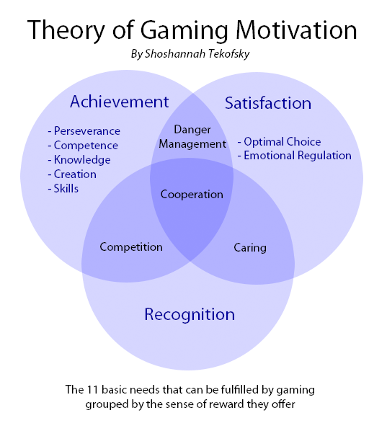
Theory of Gaming Motivation
http://www.thinkfeelplay.com/theory-of-gaming-motivation/

Slide 17
The Primary Questions - Behaviour
The usual application of gamification in a business context requires some preparation.
What behaviour are you trying to incentivise staff to improve / maintain? (The Problems)
Attendance, sickness, training progress, quality, compliance, not ready time

Slide 18
The Primary Questions - Metrics
What metrics are you going to use as the primary record of accomplishment? (The Metrics)
HR report, sickness report, training records, quality scores, quality control output, phone system reporting
Some metrics will be difficult to measure. Gamification can also be used to maintain satisfaction. Putting a cost on hiring and training new staff can be used to put a cost value to staff retention.
Gamification allows for numerous of these metrics to be used. So each of the metrics become enumerated. i.e. putting a points value on each of the outcomes. The enumeration of the events allows points / values to be gained / lost by users.

Slide 19
The Primary Questions - Rewards
What are you willing to put forward as reward for "winning"? (The Rewards)
Money, time, access to games, access to exclusive material, internal recognition
With these items answered the rest of the process is very straight forward.

Slide 20
The Project

Slide 21
The build
Psychology
Design
Data
Behaviour
Metric
Project
ADDIE approach
Reward
?

Slide 22
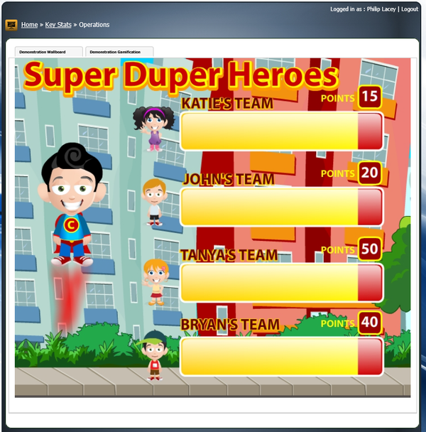
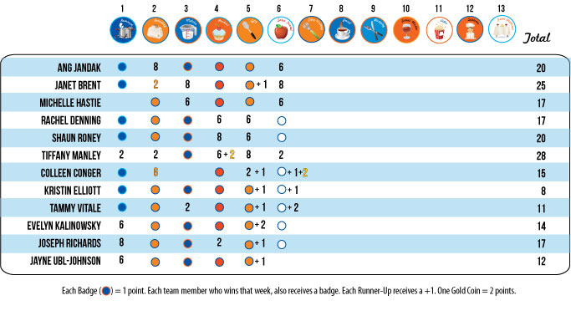
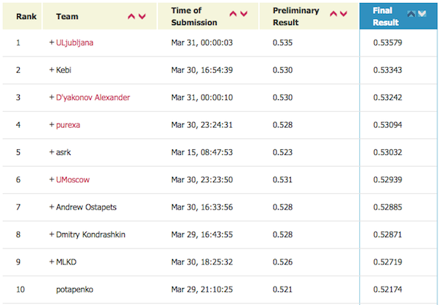
Output Type 1 - Leader board

Slide 23
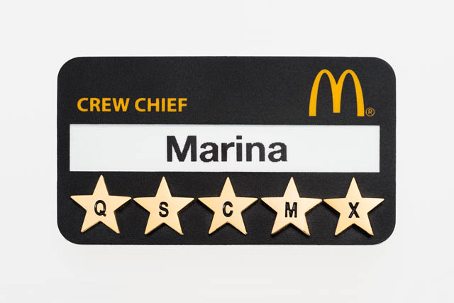
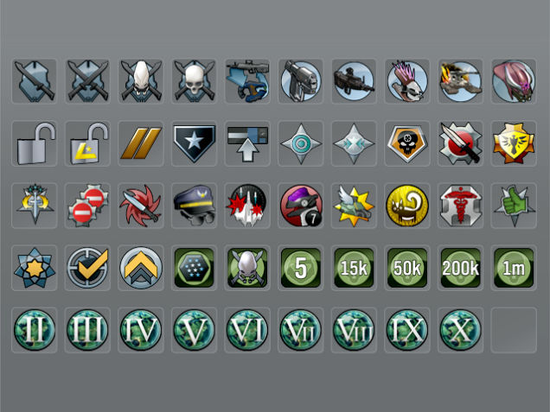


Output Type 2 - Badges

Slide 24
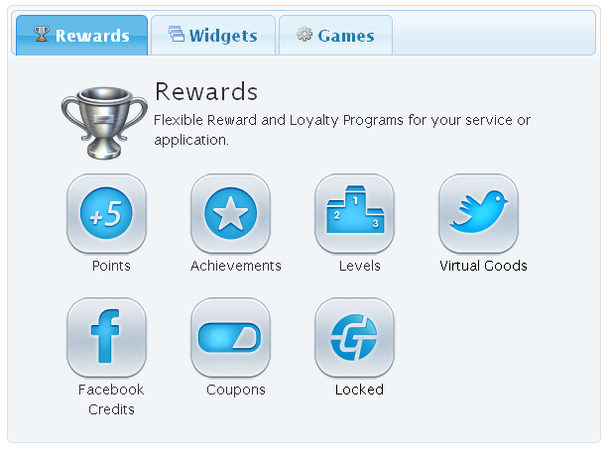

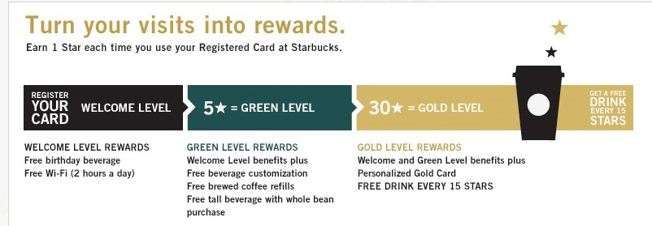
Output Type 3 - Points

Slide 25
How bxp helps?

Slide 26






Our Contribution
Our team
Partners
Psychology
Design
Data
Behaviour
Metric
Project
ADDIE approach
Reward

